Slide 1



IoT on premises
How to start an adventure with
&
&
Mariusz Krzanowski

Slide 2


About ME
Employed in IT since 1999
Developer / Architect / Team Leader
Now: Senior Software Developer @ SoftwareONE
Experienced in many technologies
.NET, SQL, SharePoint, BizTalk, Google Cloud, Android, SCCM Active Directory, Web Development … 21 years is long time ☺
I like to share my knowledge with others – you can meet me at Warszawska Grupa .NET (WG-NET)

Slide 3
Goals of the presentation
Primary goals
Secondary Goals
How to begin an adventure with IoT?
What is the minimum set of devices needed to start the fun?
Where are the limitations of current IoT devices?
Extend our current architectural knowledge, by reviewing new solutions.
Familiarizing with other approaches of solving problems.

Slide 4
Agenda:
What devices will be presented today?
What is Node-Red?
Workflow engine
What do we have out of the box
Key components
What is Mosquitto?
MQTT
Message Broker
Key components
How to start an adventure with Workflow Engine and MQTT
A lot of practical examples!
☺

Slide 5
What do we NEED TO START OUR ADVENTURE WITH IoT?
Management system
Flow design
Rules
Triggers

Slide 6
What do we NEED TO START OUR ADVENTURE WITH IoT?
Management system
Flow design
Rules
Triggers
User Interface
Dashboards
Voice

Slide 7
What do we NEED TO START OUR ADVENTURE WITH IoT?
Mediator
Coordinator to connect all elements
Management system
Flow design
Rules
Triggers
User Interface
Dashboards
Voice

Slide 8
What do we NEED TO START OUR ADVENTURE WITH IoT?
Mediator
Coordinator to connect all elements
Management system
Flow design
Rules
Triggers
User Interface
Dashboards
Voice
Devices
Sensors
Switches

Slide 9
What do we NEED TO START OUR ADVENTURE WITH IoT?
Mediator
Coordinator to connect all elements
Management system
Flow design
Rules
Triggers
User Interface
Dashboards
Voice
Devices
Sensors
Switches

Slide 10
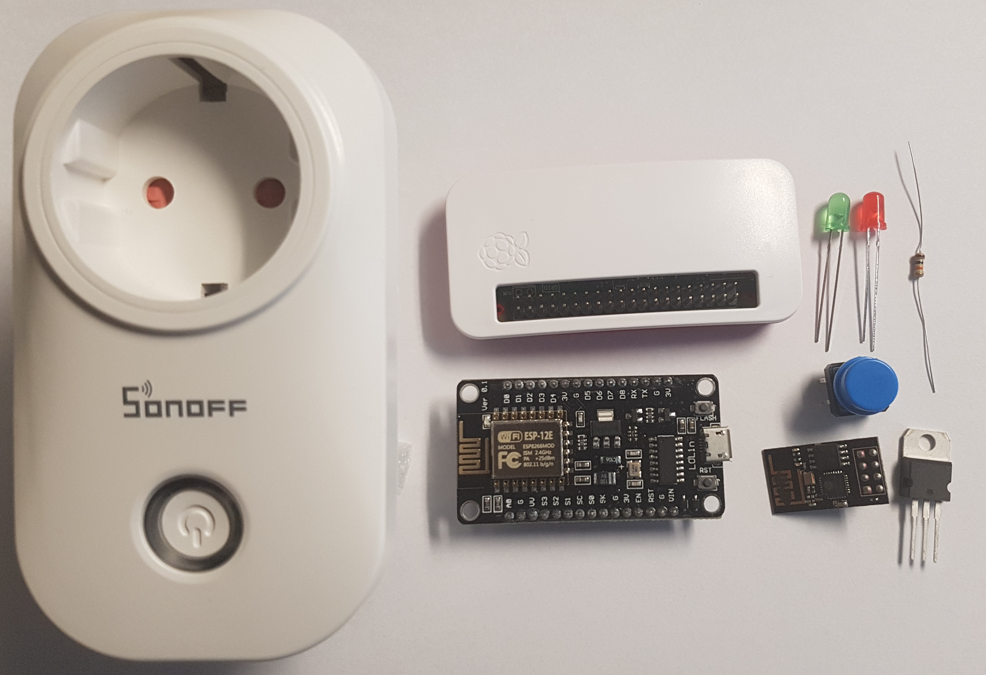
Featured devices
WI-FI Router (out of scope)
Raspberry PI Zero W (€12-€17)
ESP8266-12E board (~€6)
ESP8266-01 (~€3)
SONOFF S20 (~17€)
Diodes, thermometers, transistors, resistors, toggle switches … (~€0.1 each)
Various power supplies
Bonus ☺

Slide 11
What is Node-Red?
Developed originally by IBM as a flow design tool.
Web browser based application. Server side written in NodeJS.
Dashboard delivers: buttons, gauges and charts.
It is open-source since September 2013.
Multiple out of the box nodes - including MQTT.
JavaScript based functions.
NOTE: Preinstalled on Raspberry PI – update suggested.
https://nodered.org/

Slide 12
FYI: How to INSTALL Node-Red
sudo apt-get upate
sudo apt-get upgrade
sudo apt-get install nodered
sudo systemctl enable nodered.service
NOTE: from UI install: node-red-dashboard

Slide 13
DEMO (1) Node-Red
3 types of nodes
Input
Output
Transform
Inject Node
Debug Node

Slide 14
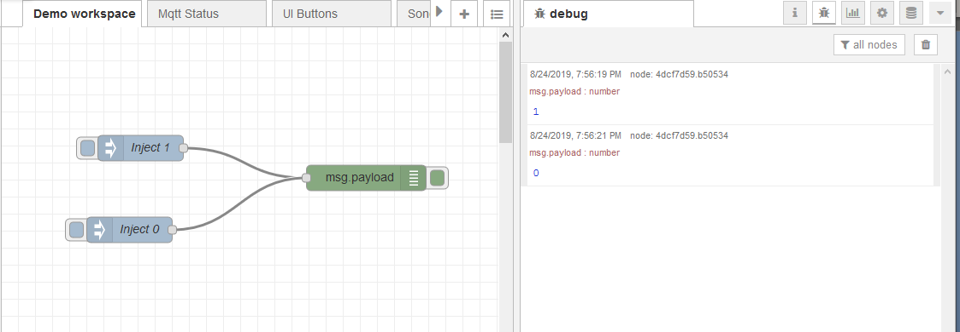
DEMO (1) Node-Red – first flow

Slide 15
DEMO (1) Node-Red – First flow
DEMO TIME ☺
http://192.169.168.10:1880/

Slide 16
DEMO (2) Raspberry PI and DIODE

Slide 17
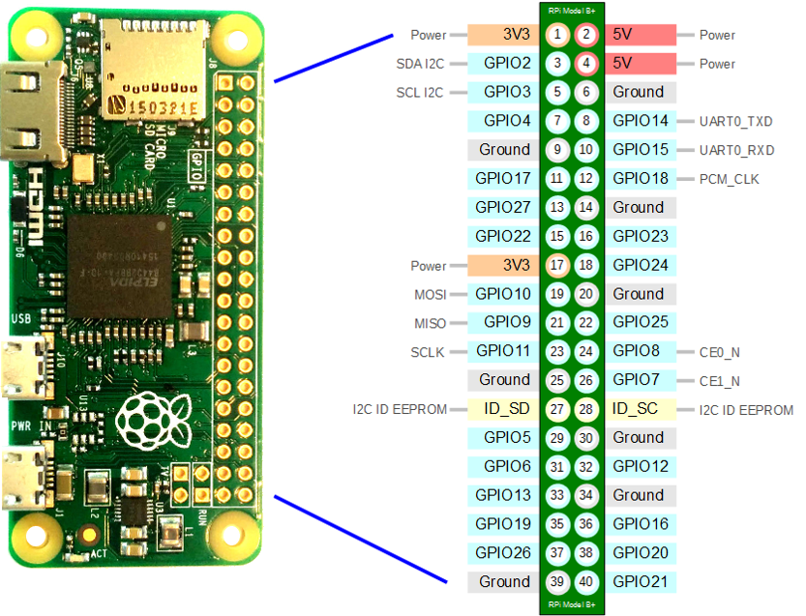
DEMO (2) - Raspberry PI W – pinout
https://raspberrypi.stackexchange.com/questions/83610/gpio-pinout-orientation-raspberypi-zero-w

Slide 18
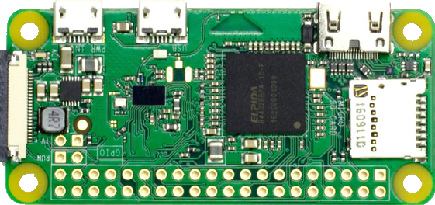
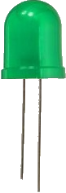
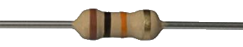
DEMO (2) Circuit schema
Longer leg is a positive electrode (+)
3.3 KΩ
GND
GPIO21

Slide 19
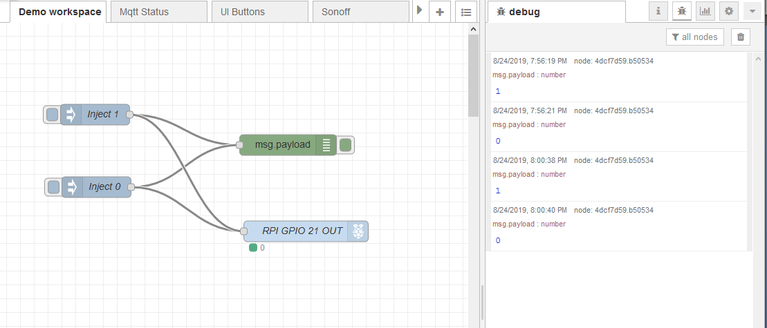
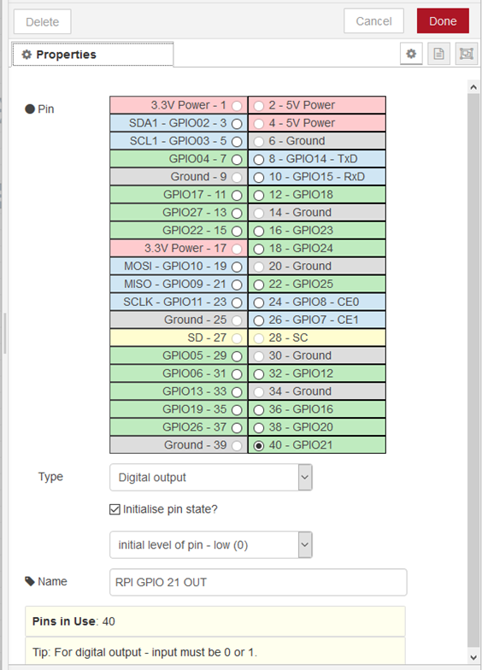
DEMO (2) Raspberry PI and DIODE

Slide 20
DEMO (2) Raspberry PI and DIODE

Slide 21
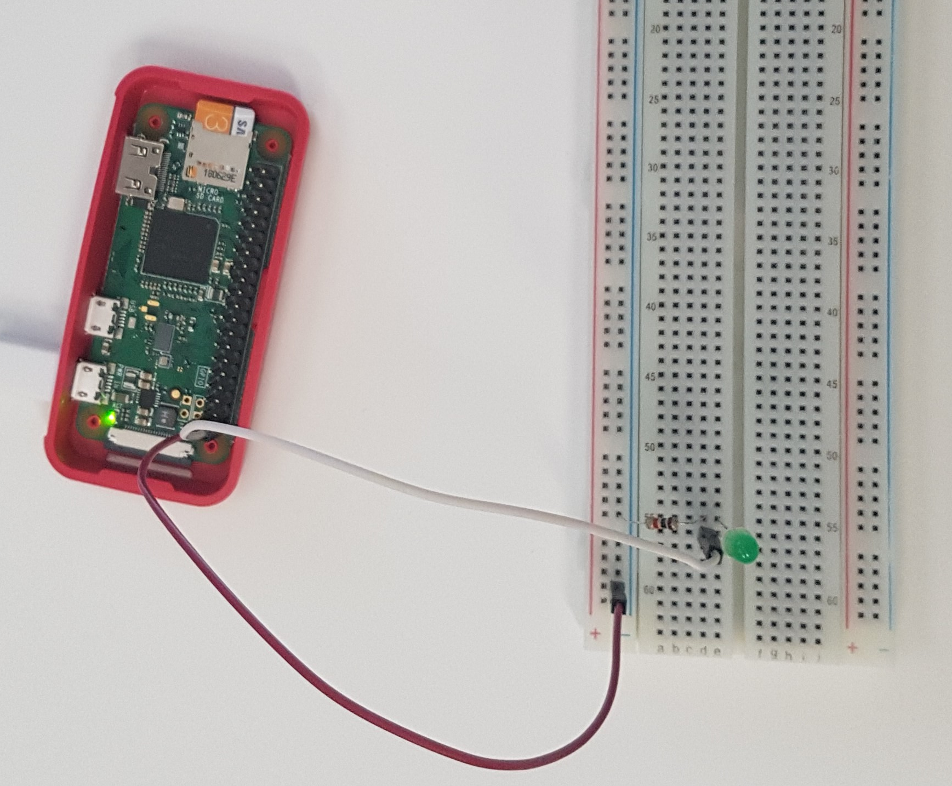
DEMO (2) - breadboard Photo
DEMO TIME ☺

Slide 22
What is Mosquitto™
Message broker that implements MQTT protocol.
MQTT stands for Message Queuing Telemetry Transport.
NOTE: Available on Raspberry PI.
Created by Roger Light in 2009.
https://mosquitto.org/
NOTE! MQTT protocol is used e.g. by:
Facebook Messenger
Microsoft Azure IoT Hub
Amazon Web Services

Slide 23
MQTT Broker architecture
Publisher 1
Subscriber 1
Publisher 2
Subscriber 2
.
.
.
.
.
.
.
.
.
.
.
.
Publisher N
Communication process is asynchronous.
Publisher does not ‘know’ any subscribers.
Subscriber N

Slide 24
MQTT – Domain language
Payload – array of bytes by default. Strings or JSON is used for better readability.
Topic – Like URI determines a category to which a message belongs. NOTE! Topics are case sensitive!
Topic examples:
/lamp/kitchen/status
/lamp/kitchen/command
/heater/dining-room/temperature
Publisher can publish messages for predefined topic.
Subscriber can subscribe for messages under specified topics.
Wildcards help to subscribe to multiple topics:
# can be used as a wildcard for all remaining levels of hierarchy e.g. /lamp/#
+ can be used as a wildcard for a single level of hierarchy e.g. /+/kitchen/+

Slide 25
FYI: How to INSTAL Mosquitto?
sudo apt-get upate
sudo apt-get upgrade
sudo apt-get install mosquitto
sudo apt-get install mosquitto-clients
sudo mosquitto_passwd -c /etc/mosquitto/passwd IotUserMqtt
sudo systemctl enable mosquitto

Slide 26
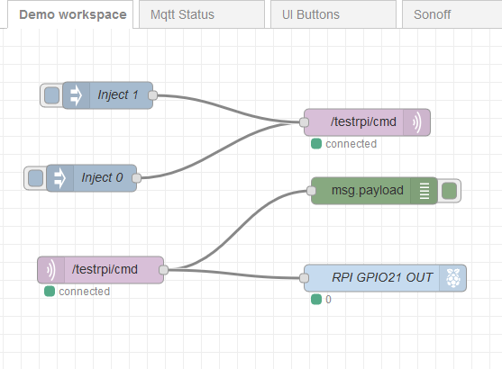
Demo (3) – MQTT on node red only
DEMO TIME

Slide 27
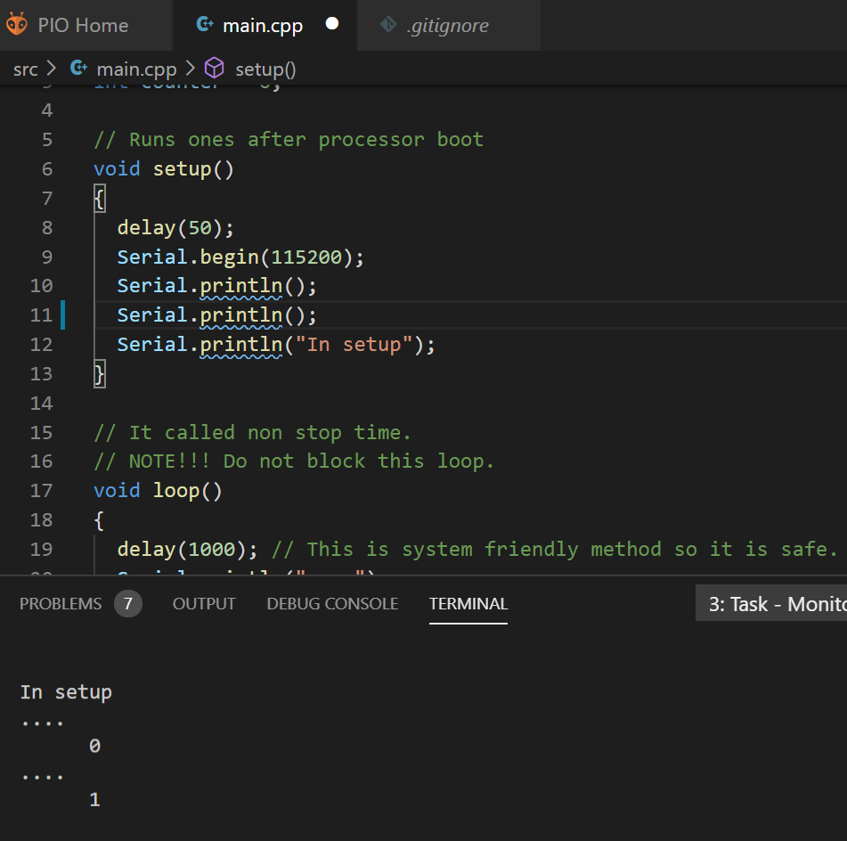
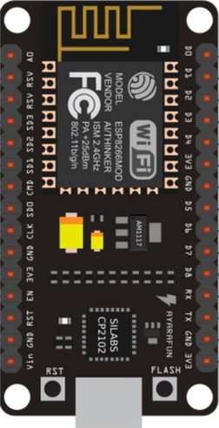
Demo (4) –ESP8266-E12 First STEPS
Device First Step
src\Arduino\SimpleSamples\01Serial

Slide 28
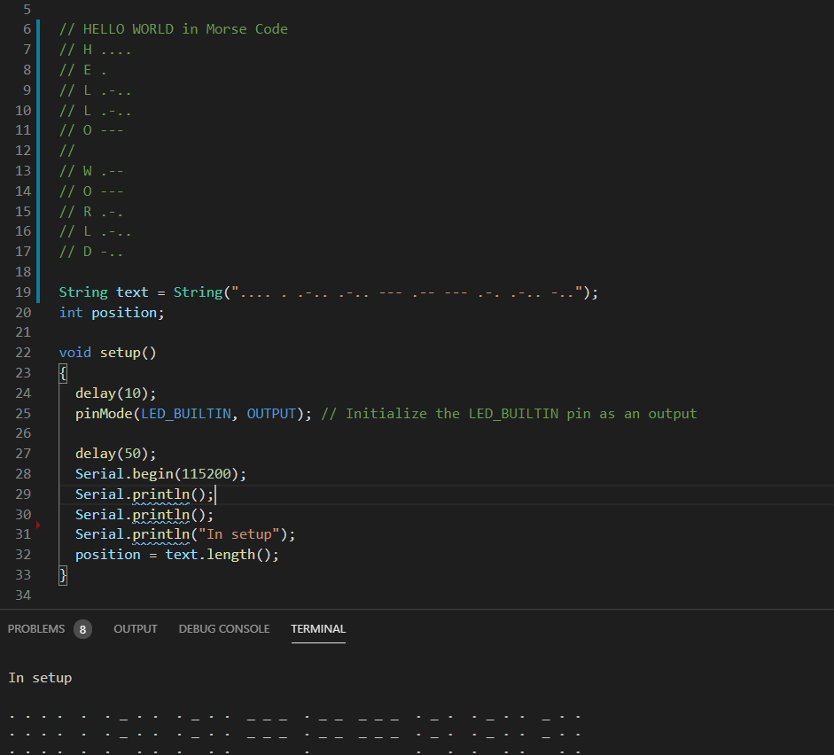
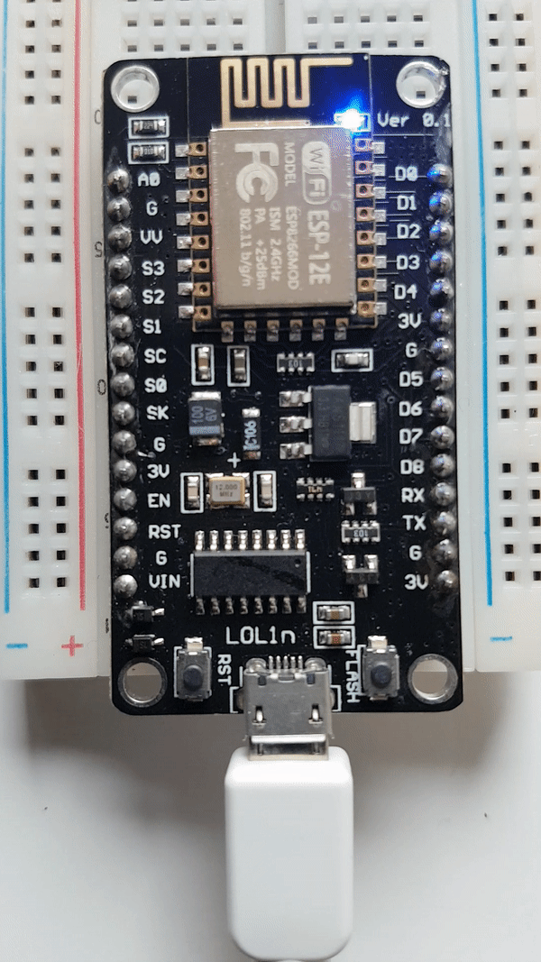
Demo (5) – ESP8266-E12 Built-in diode
Device First Step
src\Arduino\SimpleSamples\02Diode

Slide 29

Demo (6) – MQTT ON ESP8266-E12
WI-FI Router
MQTT Client
MQTT Broker

Slide 30
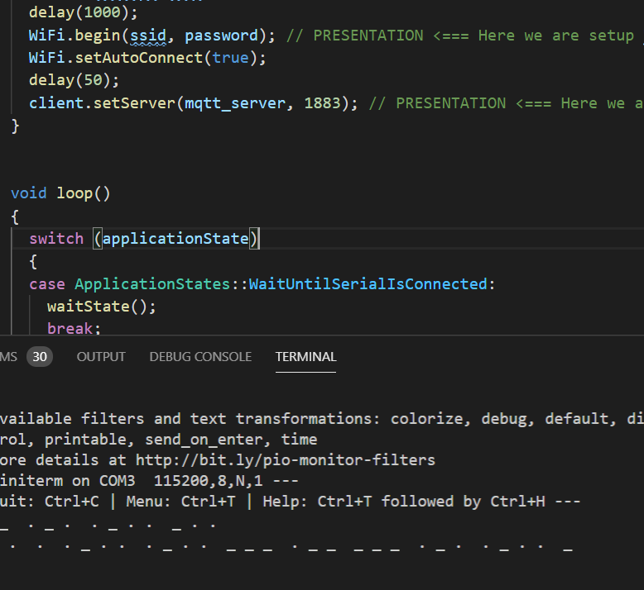
Demo (6) – MQTT ON ESP8266-E12
Device First Step
src\Arduino\SimpleSamples\03BuyButton

Slide 31
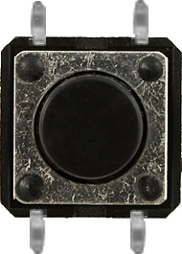
Demo (7) – MQTT ON ESP8266-E12
3.3 KΩ
D1
D3
GND
3.3 V
10KΩ

Slide 32
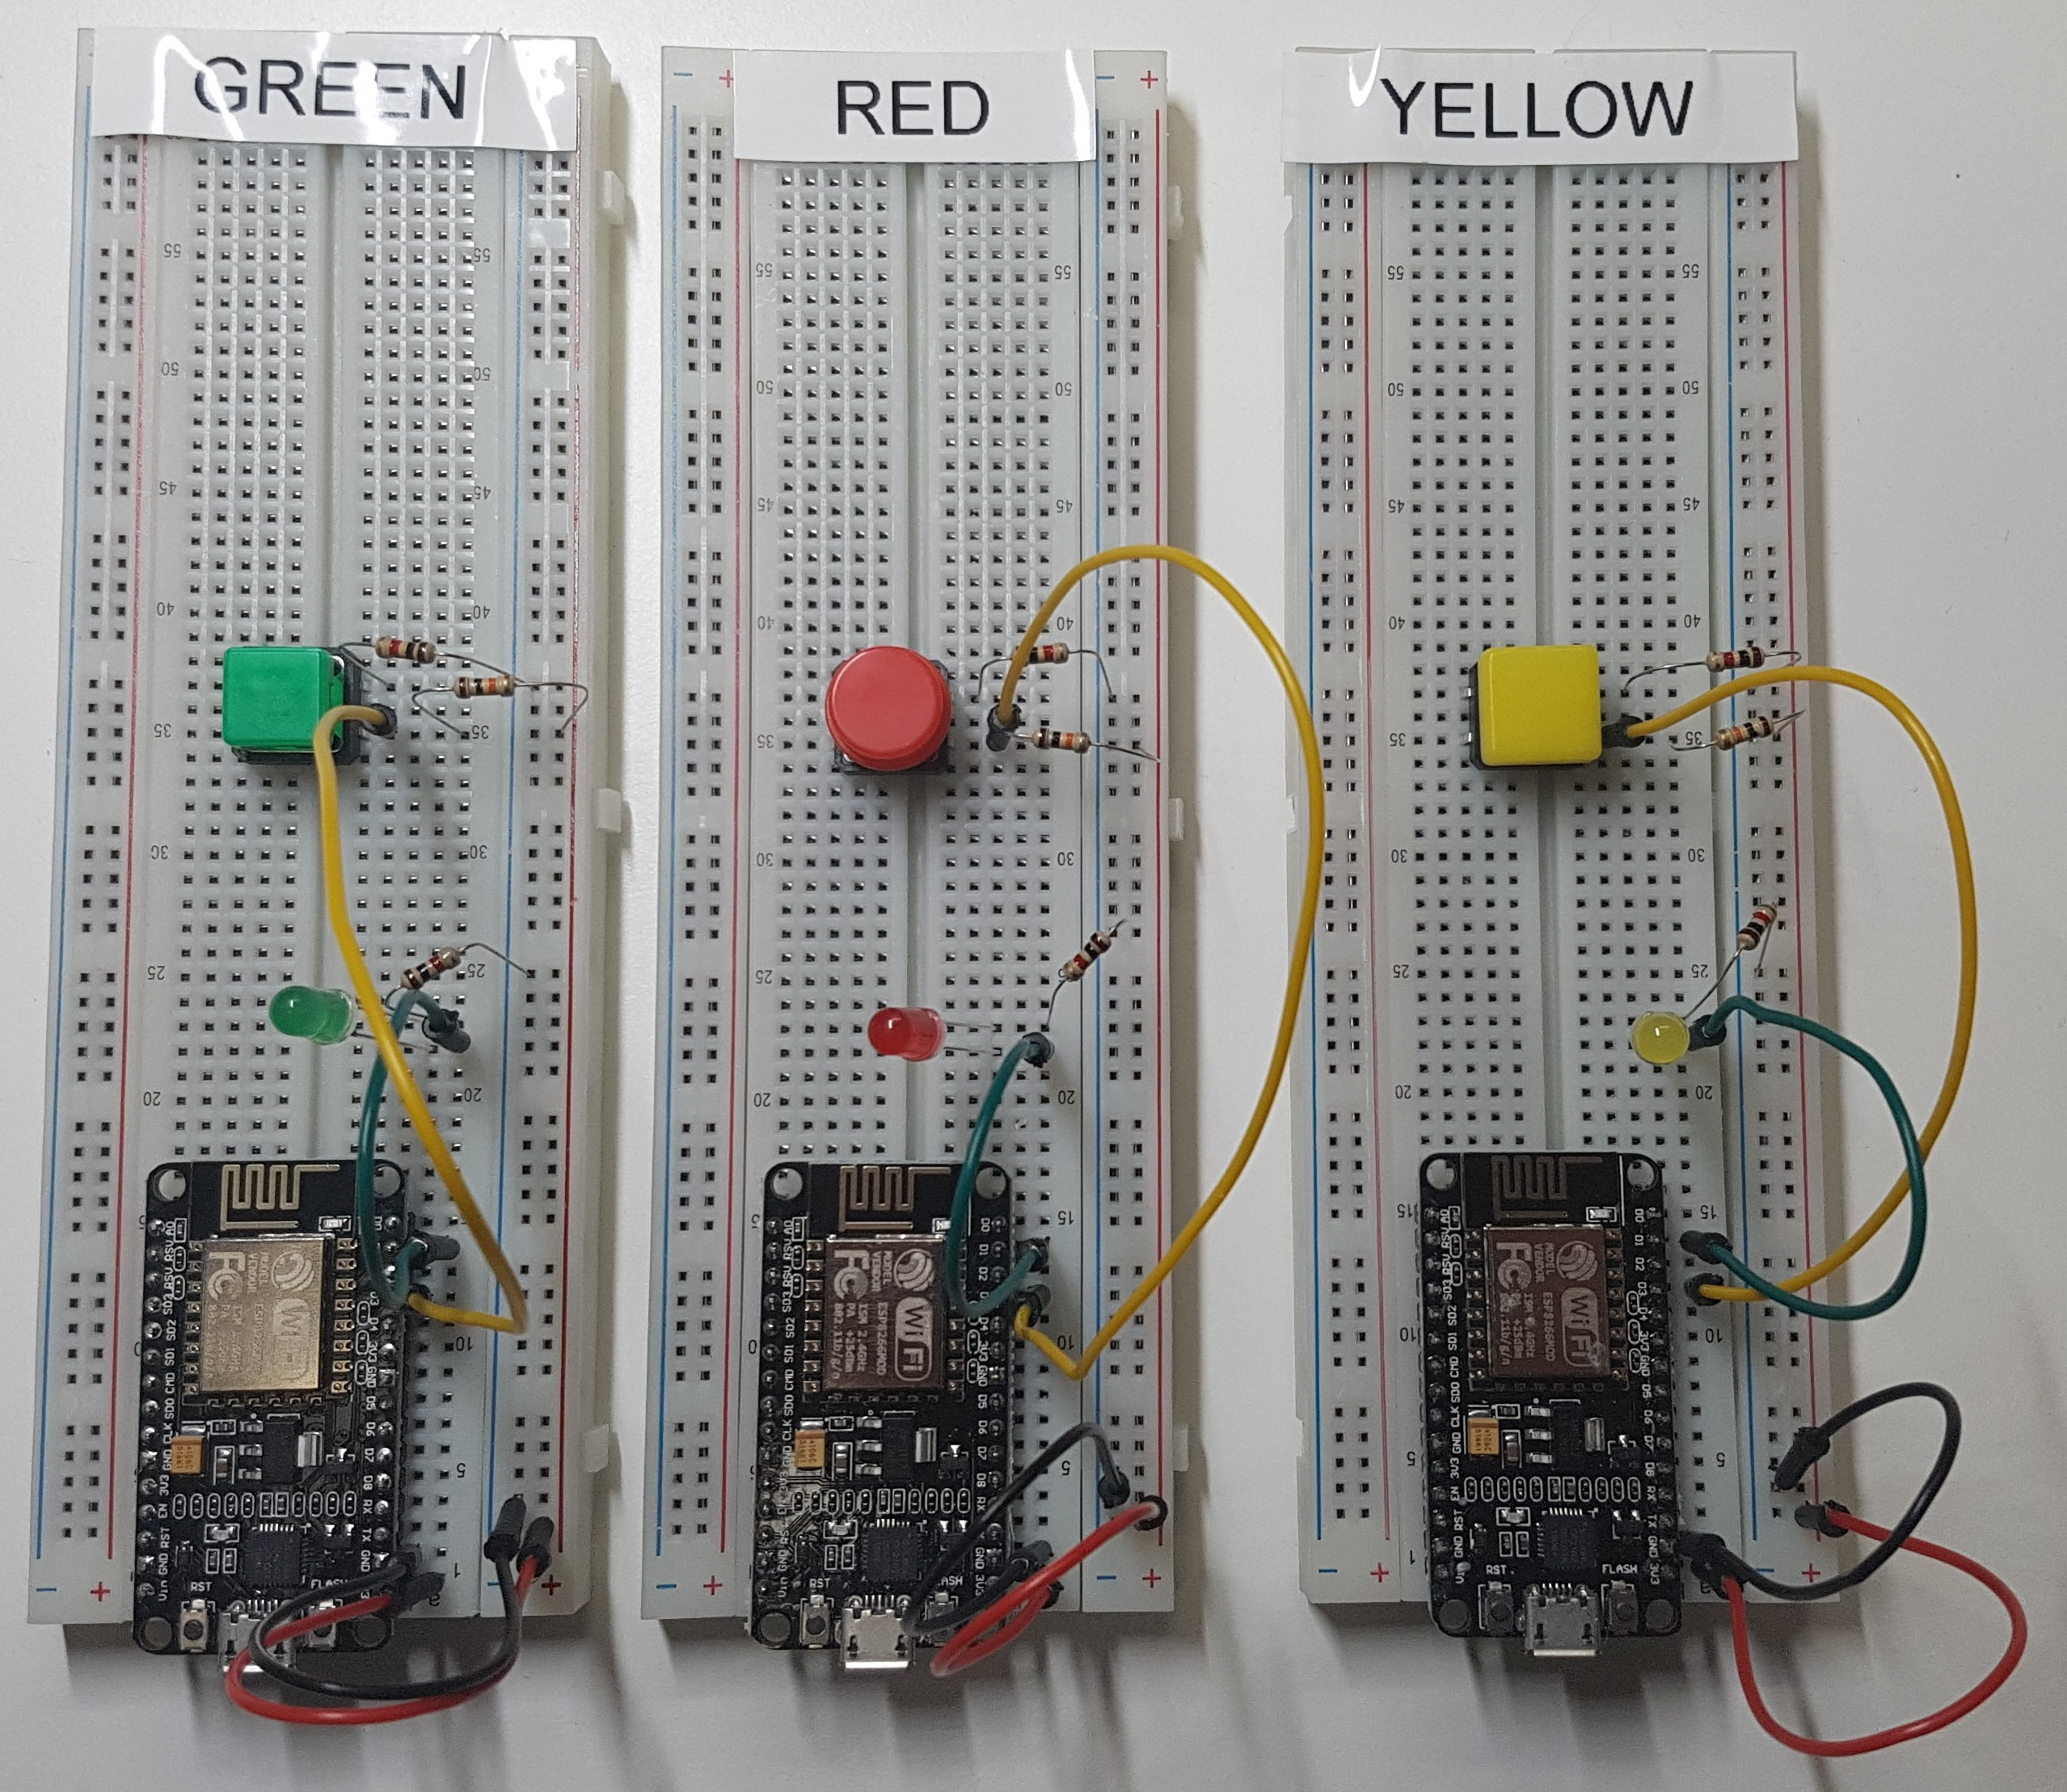
Demo (7) – MQTT ON ESP8266-E12

Slide 33
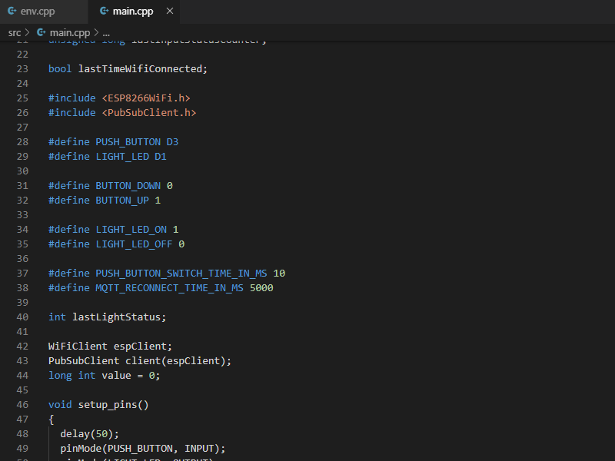
Demo (7) – MQTT ON ESP8266-E12
Source code:
src\Arduino\DiodeAndButton

Slide 34
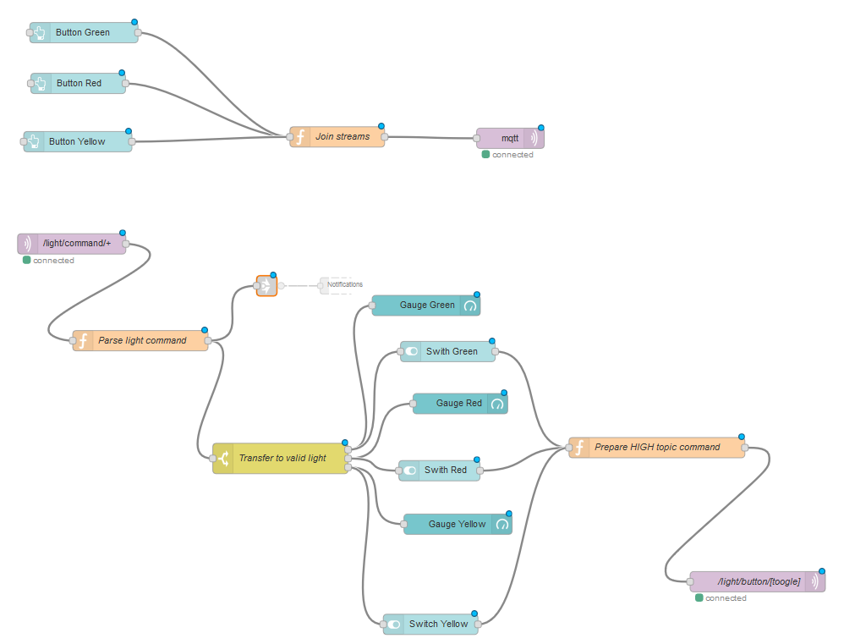
Demo (7) – MQTT ON ESP8266-E12

Slide 35
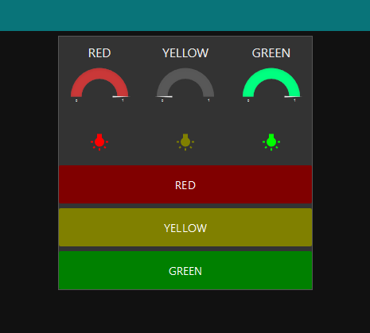
Demo (7) – MQTT ON ESP8266-E12
DEMO TIME

Slide 36
Quiz
Question:
How many wires does 1-Wire Protocol use? NOTE. It is a tricky question.

Slide 37
Quiz
Question:
How many wires does 1-Wire Protocol use? NOTE. It is a tricky question.
Answer:
3 wires in normal mode: VCC, DATA, GND
2 wires in parasite mode: VCC – DATA, GND

Slide 38
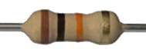
1-Wire protocol (Parasite mode)
This ‘single’ wire allows you to connect multiple devices to a single controller.
VCC
DATA
S1
S2
SN
GND
Slave node
Slave node
Slave node
Master node

Slide 39
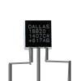
Demo (8) – Thermometer
3.3 KΩ
D1
D3
DS18B20
D7
GND
3 V
2 x 1KΩ
10KΩ

Slide 40
Demo (8) – Thermometer
3.3 KΩ
D1
D3
DS18B20
D7
GND
3 V
2 x 1KΩ
10KΩ

Slide 41
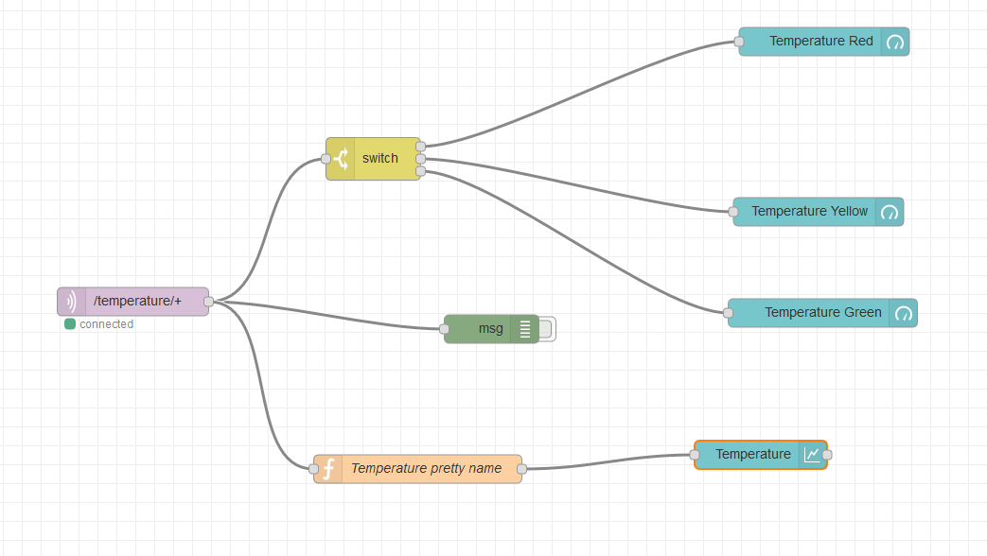
Demo(8) Thermometer

Slide 42
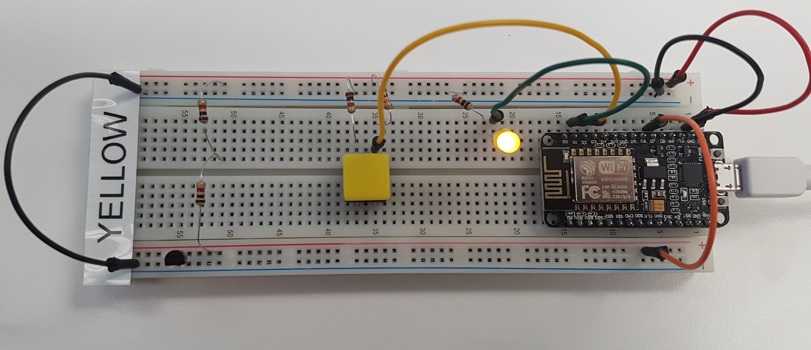
Demo(8) Thermometer
VCC
GND
Thermometer
Data Line

Slide 43
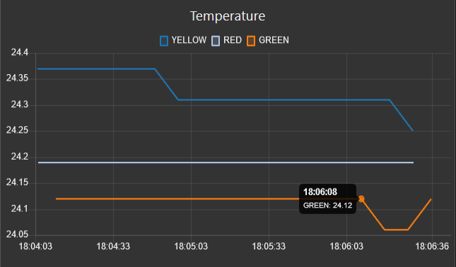
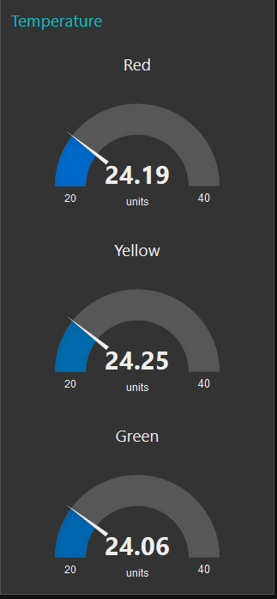
Demo(8) Thermometer
DEMO TIME

Slide 44
Sonoff S20
SONOFF is a ‘smart’ socket
It uses ESP8266-01S SoC (System on chip).
You can manage it by Android or iOS application.
You can hack it using Arduino and small hooks.

Slide 45
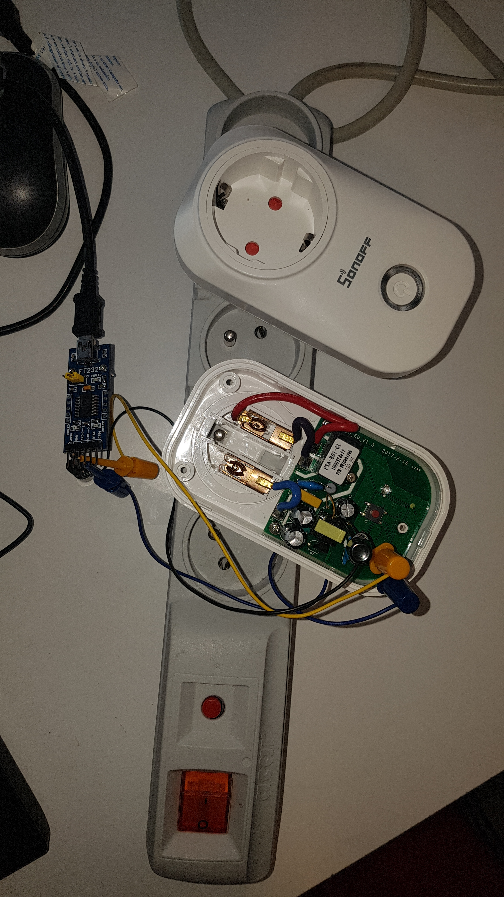
Demo(9) Sonoff S20
WARNING !!!
HIGH VOLTAGE !!!

Slide 46
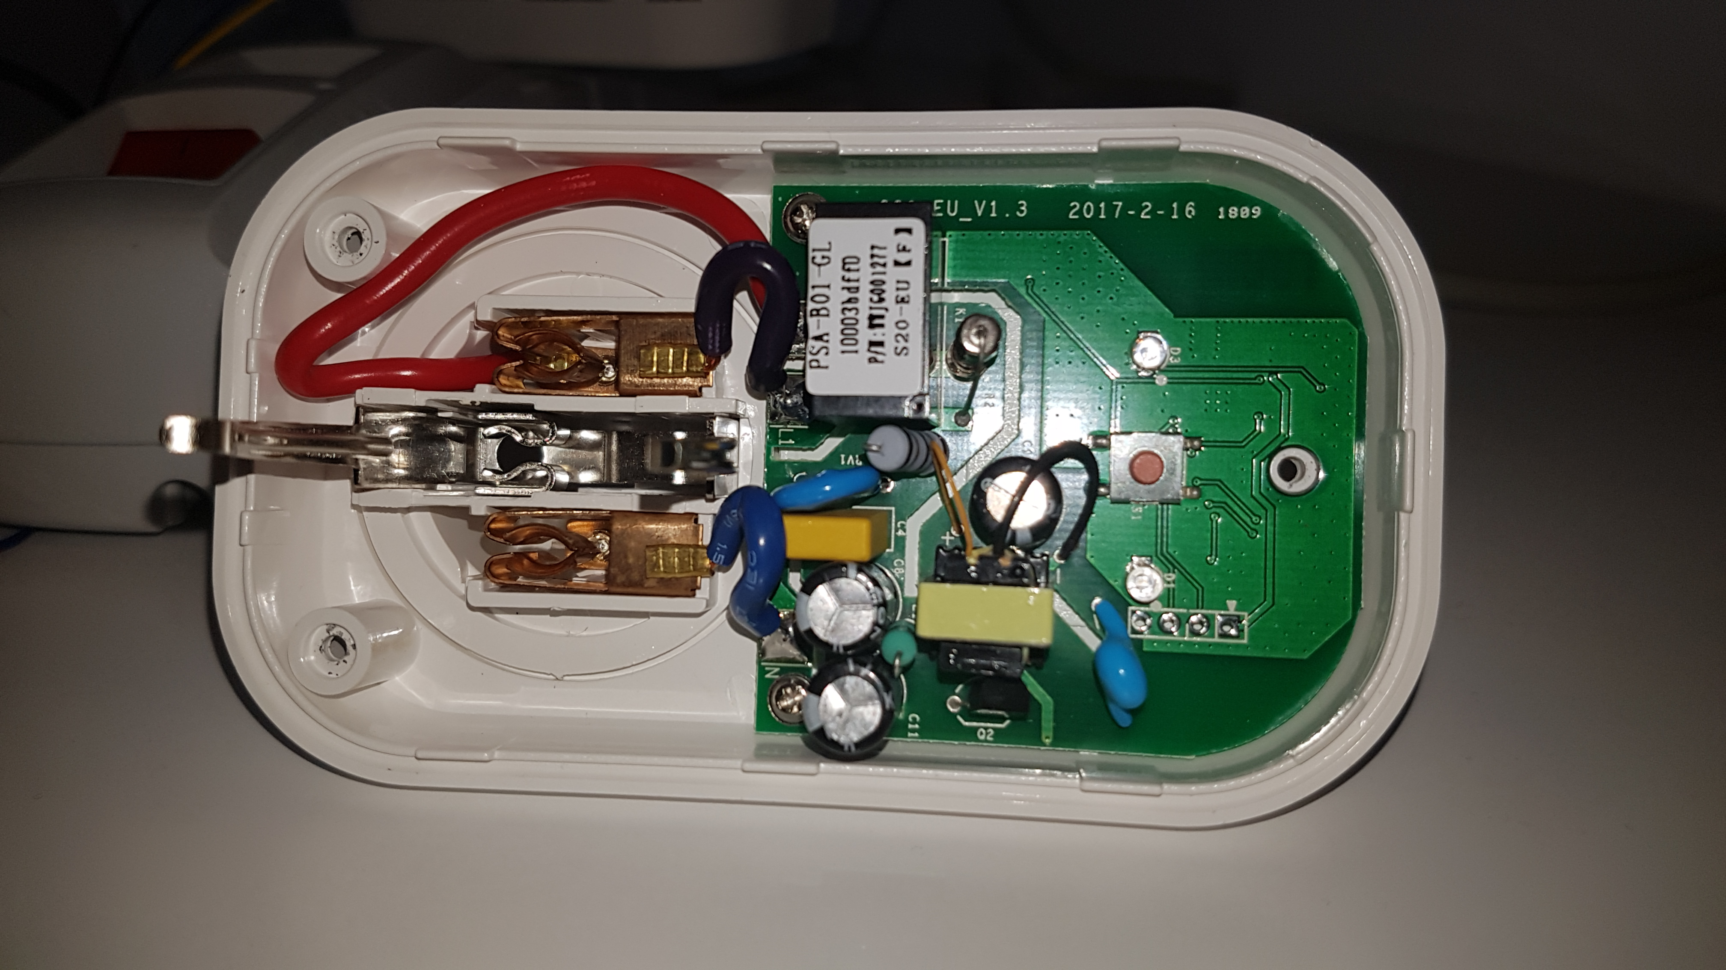
Demo(9) Sonoff S20
WARNING !!!
HIGH VOLTAGE !!!
3.3V
RX
TX
GND
GPIO 0

Slide 47
Demo(9) Sonoff S20
WARNING !!!
HIGH VOLTAGE !!!
3.3V
RX
TX
GND
GPIO 0
NOTE
You need to connect TX ⬄ RX and RX⬄ TX on your serial port adapter. ESP chipset supports only 3.3 volts. Your RS-232 adapter must support 3.3 volts on input and output ports.

Slide 48
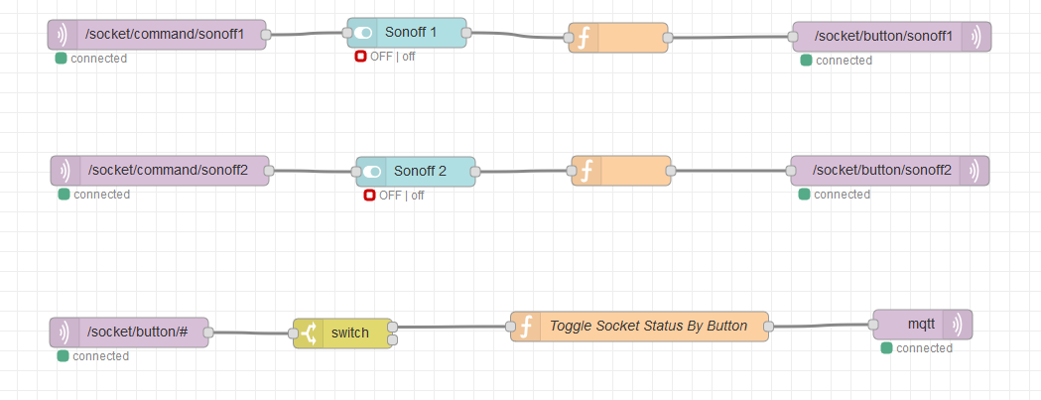
Demo(9) Sonoff S20

Slide 49
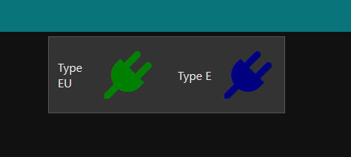
Demo(9) Sonoff S20
DEMO TIME ☺

Slide 50
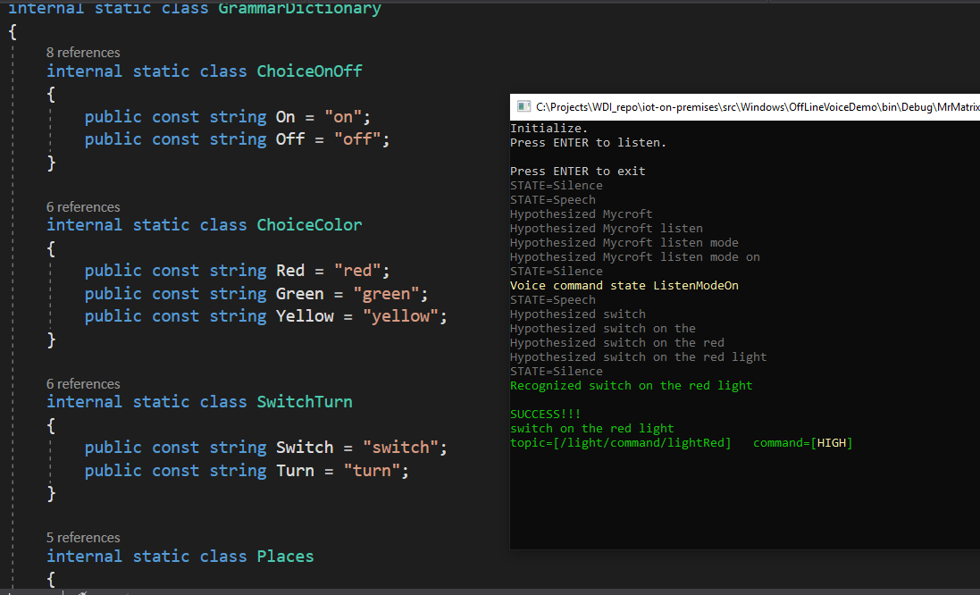
BONUS (1) MQTT & VOICE CLIENT (C#)
Mycroft. Switch on the red light.

Slide 51
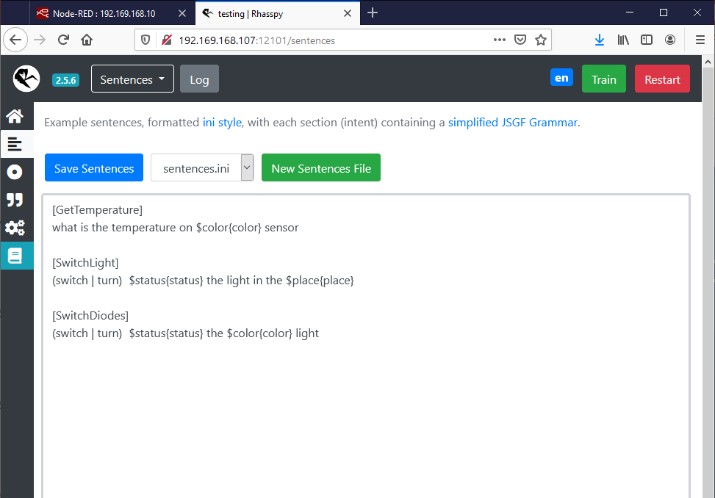
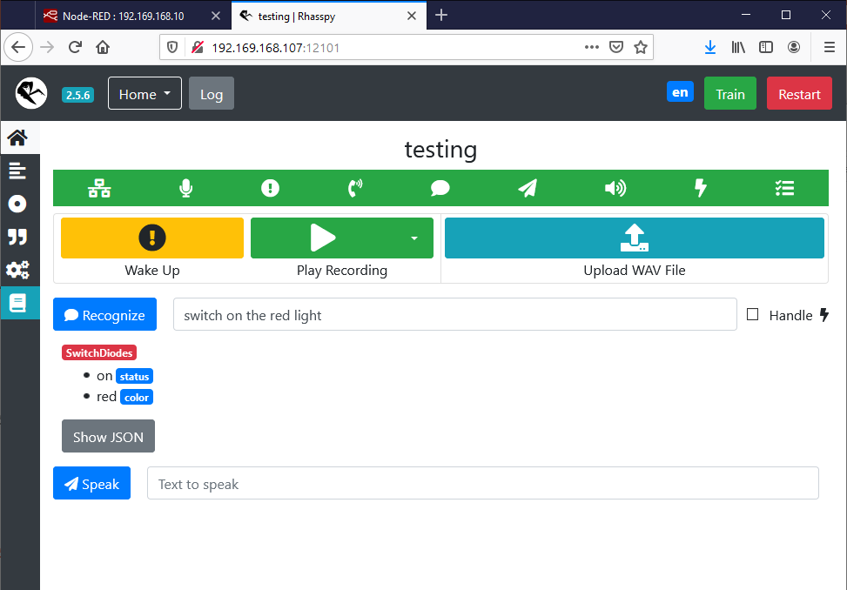
BONUS (2) MQTT & VOICE CLIENT (Rhasspy)
Porcupine. Switch on the red light.

Slide 52
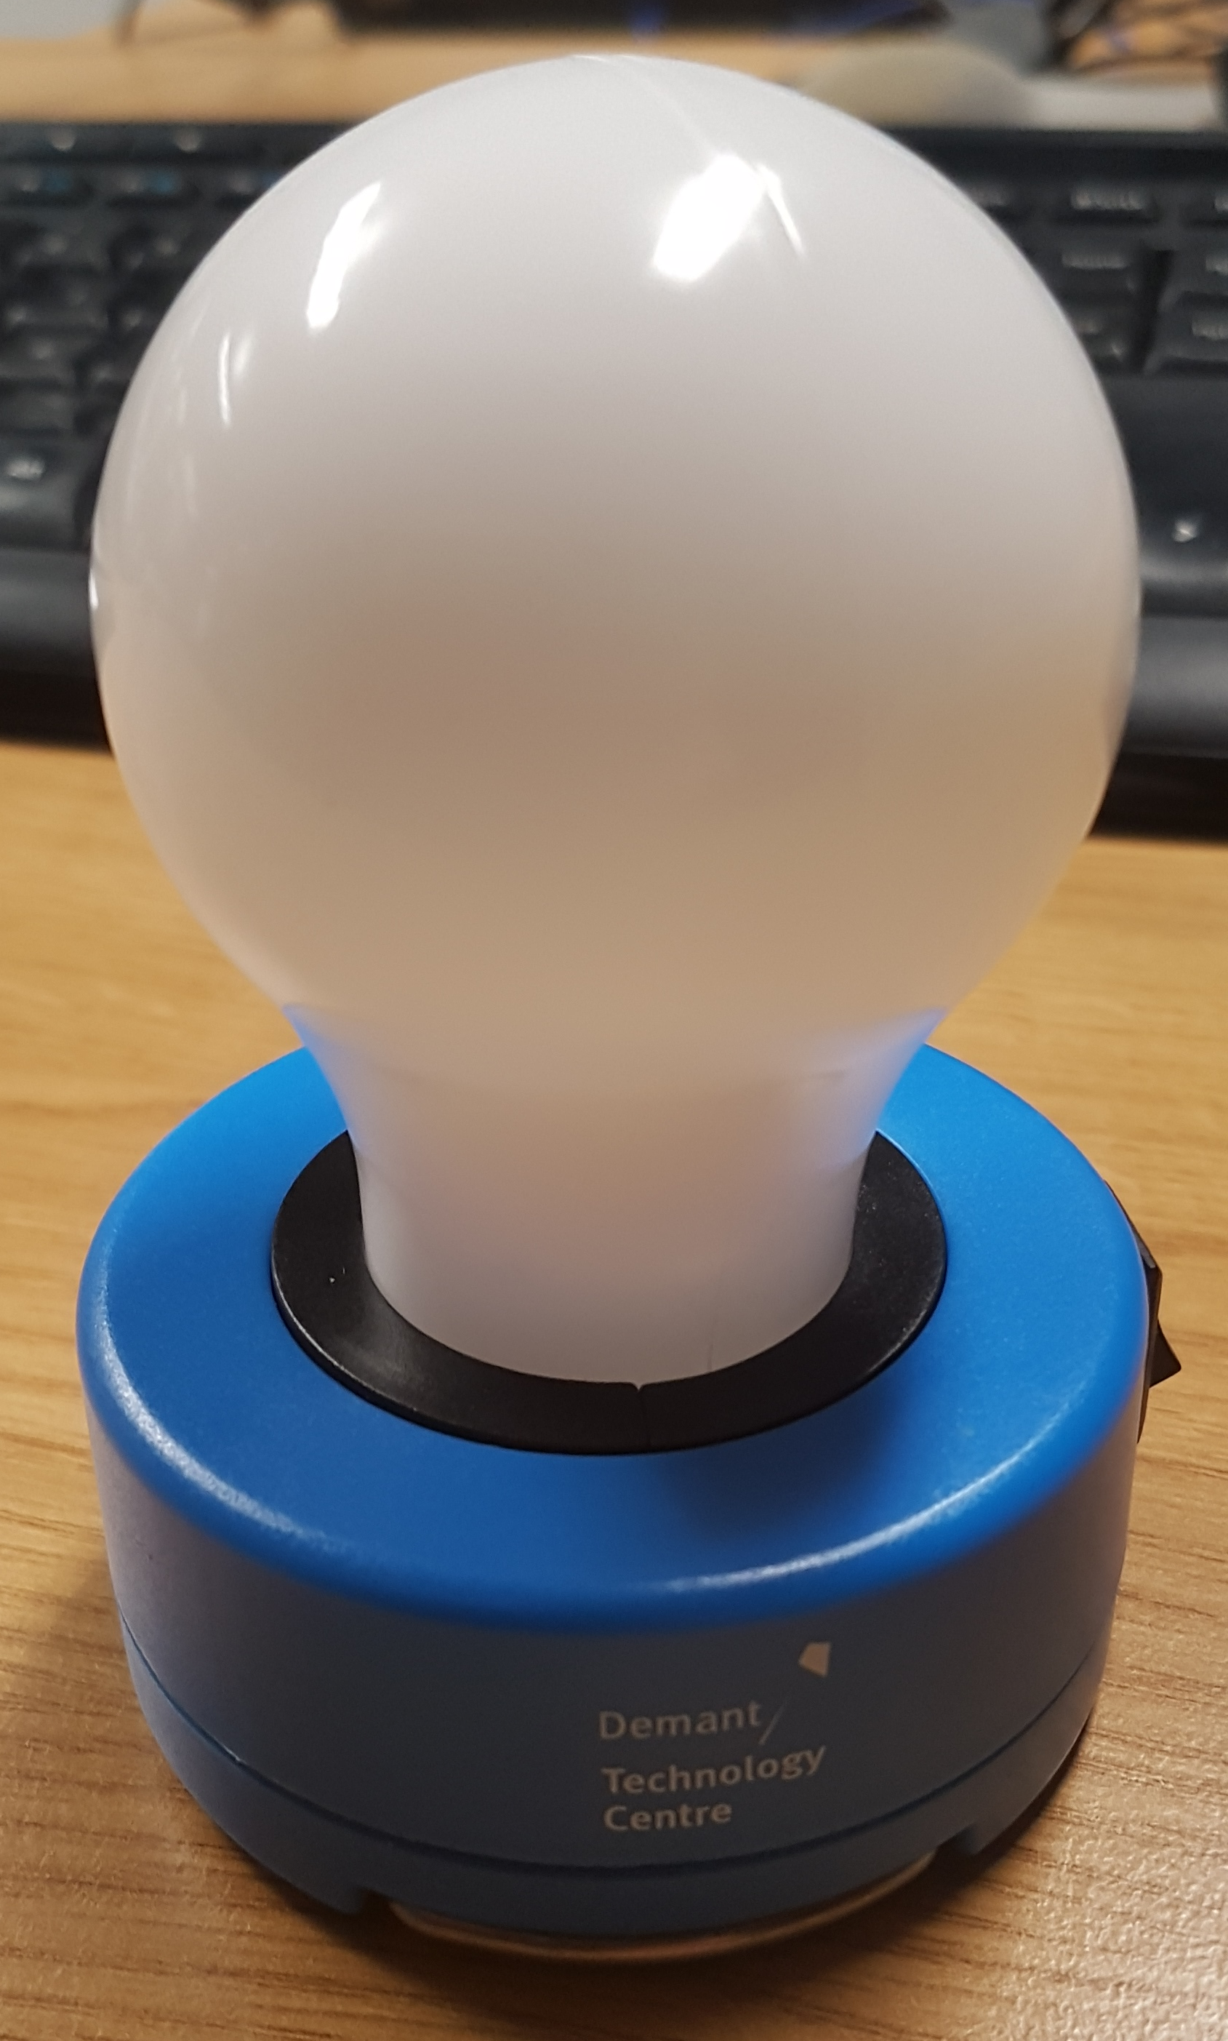
BONUS (3) Smart LAMP
What will happen when you change initial product purpose and extend its usability?

Slide 53
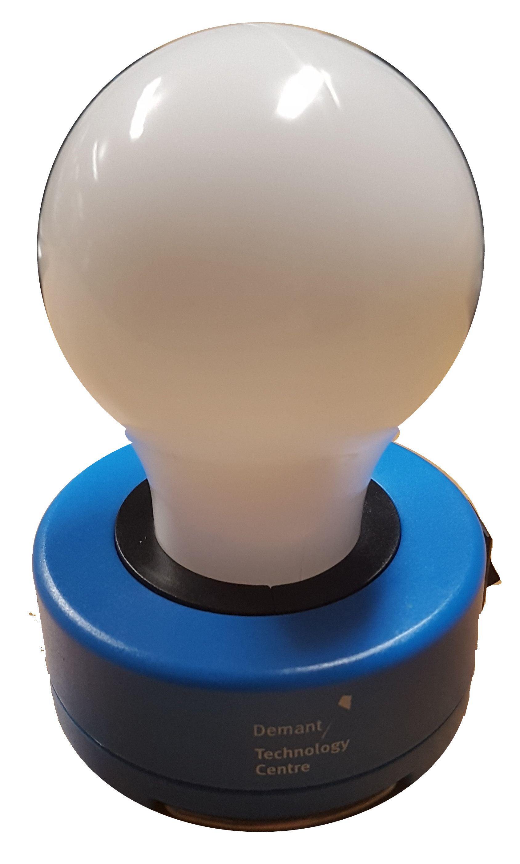
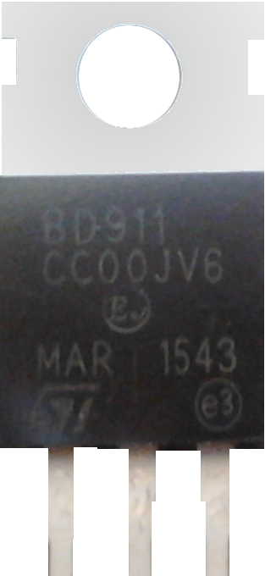
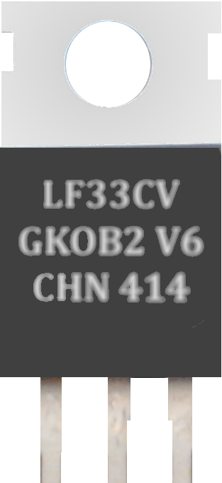

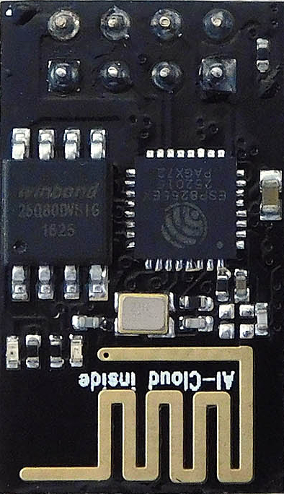
BONUS (3) Smart LAMP
B-C-E
I–G-O
GPIO2
4,7K Ω
4,7K Ω

Slide 54
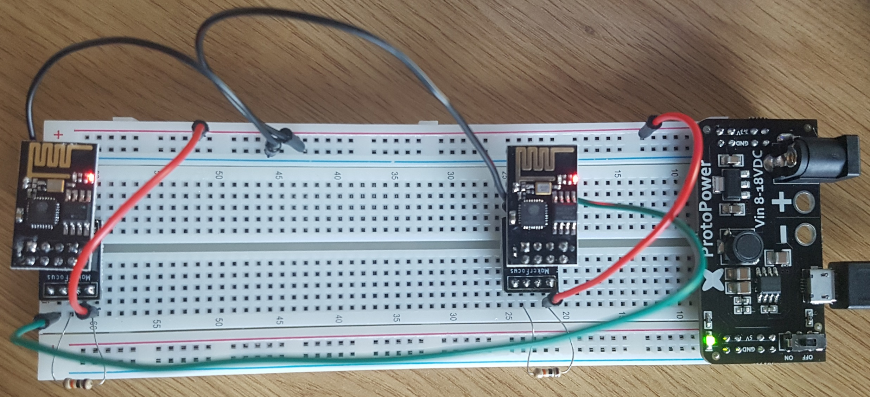
BONUS (4) WI-FI Sniffer

Slide 55
BONUS (4) WI-FI Sniffer
I–G-O
RX⬅TX
Forwarder
Sniffer

Slide 56
Summary
Node-Red™ and Mosquitto™ are really easy to use.
Both products have been on the market for long and they represent mature solutions.
To start you need to spend less than €30 plus your time.
Visual Studio Code™ and PlatformIO™ make an easy entry level.

Slide 57
References
Node-RED
https://nodered.org/
Eclipse Mosquitto™
https://mosquitto.org/
Rhasspy Voice Assistant
https://rhasspy.readthedocs.io/en/latest/
AUTODESK ® TINKERCAD™
https://www.tinkercad.com/circuits

Slide 58
References
Andreas Spiess
https://www.youtube.com/channel/UCu7_D0o48KbfhpEohoP7YSQ
Kevin Darrah
https://www.youtube.com/user/kdarrah1234
MATRIX Labs - Episode 201: Get Started w/ Rhasspy Offline Voice Assistant
https://www.youtube.com/watch?v=I9n4NCLTg0k
Electronoobs
https://www.youtube.com/channel/UCjiVhIvGmRZixSzupD0sS9Q

Slide 59
References
GreatScott!
https://www.youtube.com/user/greatscottlab
bitluni's lab
https://www.youtube.com/user/bitlunislab
Electronoobs
https://www.youtube.com/channel/UCjiVhIvGmRZixSzupD0sS9Q
Ben Eater
https://www.youtube.com/channel/UCS0N5baNlQWJCUrhCEo8WlA

Slide 60

Where you can find me?
Web
https://lastboardingcall.pl
https://mrmatrix.net
GitHub
https://github.com/MariuszKrzanowski
Tweeter
@KrzanowskiM
Meetups
Warszawska Grupa .NET
Mariusz Krzanowski

Slide 61
Q & A

Slide 62
Thank you
☺

Slide 63
Where you can find me?
Web
https://lastboardingcall.pl
https://mrmatrix.net
GitHub
https://github.com/MariuszKrzanowski
Tweeter
@KrzanowskiM
Meetups
Warszawska Grupa .NET
Mariusz Krzanowski

